Slide 1
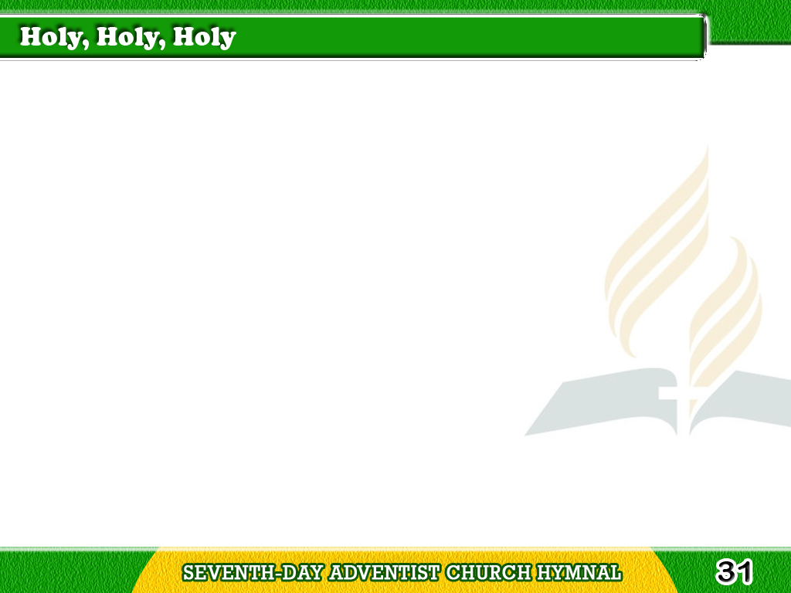

1/4
Holy, holy, holy!
Lord God Almighty!
Early in the morning
our song shall rise to Thee;
Tagalog
Version

Slide 2
1/4
Holy, holy, holy!
merciful and mighty!
God in three persons,
blessed Trinity!
Tagalog
Version

Slide 3
2/4
Holy, holy, holy!
Angels adore Thee,
Casting down their bright crowns
around the glassy sea;
Tagalog
Version

Slide 4
2/4
Thousands and ten thousands
worship low before Thee,
Which wert, and art,
and evermore shalt be.
Tagalog
Version

Slide 5
3/4
Holy, holy, holy!
Though darkness hide Thee,
Though the eye of man
Thy great glory may not see;
Tagalog
Version

Slide 6
3/4
Only Thou art holy!
there is none beside Thee,
Perfect in power,
in love and purity.
Tagalog
Version

Slide 7
4/4
Holy, holy, holy!
Lord God Almighty!
All Thy works shall praise
Thy name in earth
and sky and sea;
Tagalog
Version

Slide 8
4/4
Holy, holy, holy!
merciful and mighty!
God in three persons,
blessed Trinity!
Tagalog
Version

